Slide 1
Social assistance schemes across the world: eligibility conditions and benefits
Emil Tesliuc
with Carlo del Ninno and Margaret Grosh
World Bank

Slide 2

Based on
Notes:
Good morning. The previous lecture has reviewed some of the key design parameters of social assistance programs in the OECD countries -- target groups, eligibility criteria and the generosity of these programs. I will do the same for developing countries.
The paper I am presenting draws heavily from a recent book co-authored with M Grosh and CDNinno “for protection and promotion”, which reviews xx programs from xx developing countries. Academic and grey literature.

Slide 3
Outline
1
Type of safety net programs
Spending
Target group, targeting methods
Benefit level, from theory to practice
Distributional outcomes
2
3
4
5
Notes:
This paper is just a small “decoupage” from that book. It covers:

Slide 4
Definitions
1
Safety nets are non-contributory transfer programs targeted to the poor or those vulnerable to shocks and policy:
  In kind transfer, mostly food-based
  Cash transfers
  Conditional cash transfers
  Public works (labor intensive) or workfare
  Fee waivers for health or education
  General price subsidies, e.g. for food or fuel
Similar to what is called social assistance in Europe or welfare programs in English-speaking countries, but with more varied forms of programs in developing countries.
4
Notes:
Let me start by defining the topic
… what type of programs I cover
… size of the safety net in developing countries
… objective, target group and typical targeting methods
… benefit levels, in theory and practice
… some lessons

Slide 5
Outline
1
Type of safety net programs
Spending
Target group, targeting methods
Benefit level, from theory to practice
Distributional outcomes
2
3
4
5
Notes:
This paper is just a small “decoupage” from that book. It covers:

Slide 6
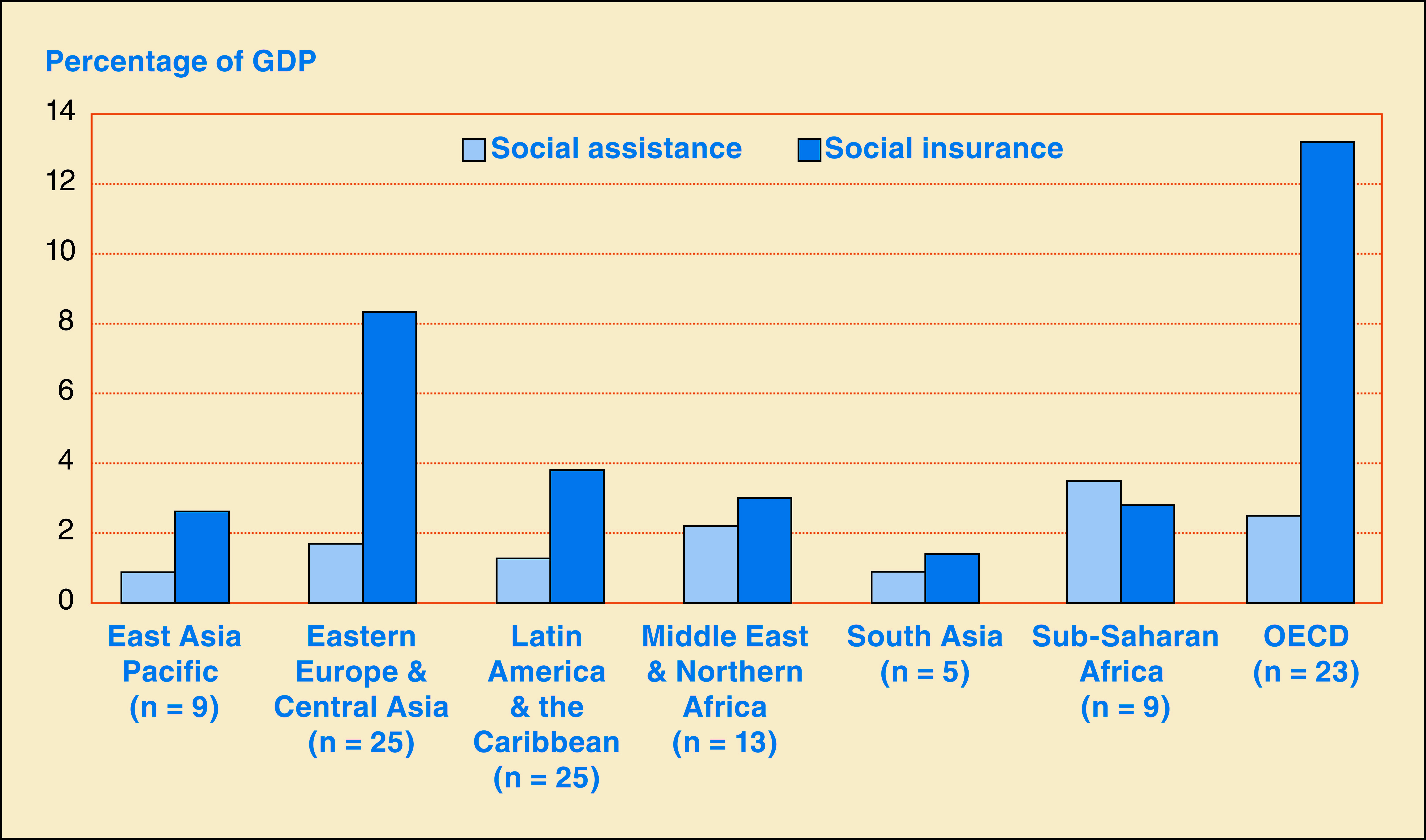
Levels of social assistance and social insurance spending, by region
2

Slide 7
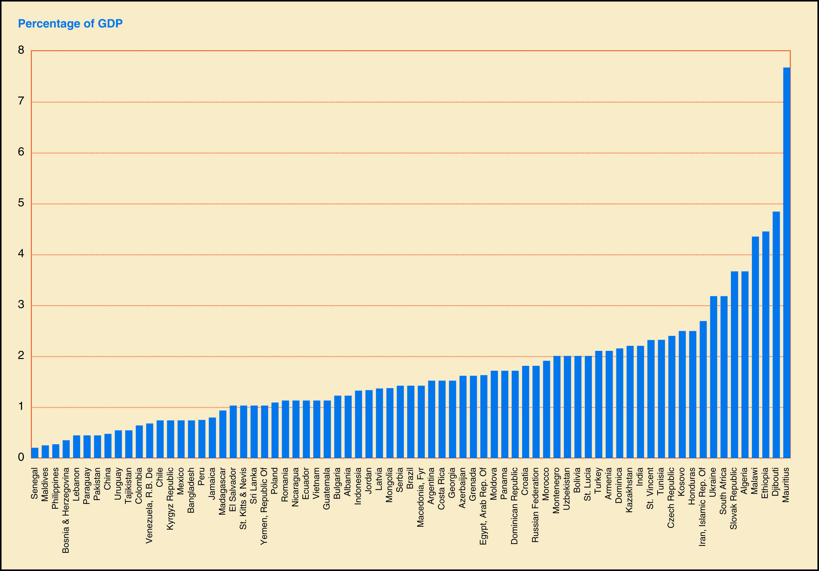
Spending on safety nets is modest
2
Mean 1.7% of GDP; median 1.4% of GDP (n=72)
For 1/2 of countries is about 1-2 % of GDP
Notes:
(replace this slide with the right color version)
Spending on these programs are in the range of 1-2% of GDP, with outliers in both directions – under- and over-spenders.
And
These programs are only a fraction often a small fraction, of the overall SP or social policy spending. Implies that finding fiscal space is not so hard as sometimes thought.

Slide 8
Outline
1
Type of safety net programs
Spending
Target group, targeting methods
Benefit level, from theory to practice
Distributional outcomes
2
3
4
5
Notes:
This paper is just a small “decoupage” from that book. It covers:

Slide 9
Targeting Methods
3
Self-Selection
  By purchase of commodity
  Work requirement
Categorical/Group
  Geographic (poverty maps)
  Demographic (kids, elderly, lone parents, other)
Individual Assessment
  Community-based
  Proxy means
  Means (income & assets testing)
Requires less administrative capacity
Requires more administrative capacity
9
Notes:
9

Slide 10
Food and In-kind Transfers
3
Quantity rations and in-kind transfers, Supplemental feeding and nutrition, School feeding, Emergency food distribution
Intended Beneficiaries
Poor people that need to improve nutritional status
Malnourished children; pregnant and lactating mothers;
Those attending schools in poor communities
Refugees and other misplaced population
Targeting Methods
Geographic
Self-targeting (using inferior commodities)
Means or proxy means
Key Design Features
Need to be able to store and transport food
Advantages
Can be effective in alleviating hunger
Can increase school attendance for poor children
Disadvantages
Storage and transport of food adds large element to admin costs
Limited beneficiary group
Substantial errors of inclusion depending on targeting method
Often biased to urban populations
On-site feeding adds to admin costs, transactions cost for participants
Appropriate Context
    Prices are too high because of lack of or inefficient markets.
    As long as does not have a negative impact on markets.
    Nutrition interventions are needed to protect food insecure people
    Food aid is available but cash assistance not, or government needs to rotate strategic food grain stocks

Slide 11
Cash Transfers
3
Needs based transfers, food stamps, non-contributory pensions, family allowances
Intended Beneficiaries
Poor working families
Those not expected to work – children, the elderly, disabled
Those needing temporary relief
Targeting Methods
Means and proxy means and/or
Categorical: children, old, disabled, etc.
Key Design Features
        Good administration for selection and distribution
        Distribution and reclamation chain for food stamps
Advantages
Have lower administrative costs than many other programs
Do not distort prices
Transfers can directly meet critical household needs
Benefits can be differentiated by level of need, household size or composition, etc.
Disadvantages
Targeting methods can be information intensive
Transfers are fungible, subject to unintended household uses
Appropriate Context
        Essential commodities are available
        Consumers purchase food in the market

Slide 12
Conditional Transfers
3
Targeted transfers conditional on school attendance or preventative health care
Intended Beneficiaries
Poor and vulnerable families with low level of human capital
Targeting Methods
Means or proxy means and/or
Categorical Geographic and/or
Community (together with one of above)
Key Design Features
        Same as cash
        Efficient way to verify compliance
Advantages
Supports income of the poor
Can improve school attendance and/or health care use
Disadvantages
Effectiveness influenced by existing education/health infrastructure
Administratively demanding – needs sophisticated targeting by monitoring of compliance
Appropriate Context
        Health and education services are available
        Poor are not making use of them
        Administrative constraint not too big

Slide 13
Public Works
3
Labor-intensive, usually infrastructure development projects
Intended Beneficiaries
Poor unemployed at the margin of labor market
Poor short term unemployed and seasonal workers
Targeting Methods
Self selection by setting program remuneration below the minimum wage
Geographic
Other means of rationing if needed – community based targeting, proxy means testing, or the like.
Key Design Features
The work must be productive with serious effort put into selecting and supervising projects and enough spent on
non-labor costs.
The wage musts be set low enough to achieve self-targeting.
A range of possibilities for institutional structures
Advantages
Needed infrastructure is created or maintained
Self targeting can be effective if wage rate low enough
If the program is set up with an “employment guarantee” there are additional risk management benefits
Politically popular because can avoid labor disincentives and maintain the “dignity of work”
Disadvantages
Administratively demanding.
Tradeoff between infrastructure development and poverty alleviation objectives
Net transfer- to- total- cost ratio low because of the share of non-wage inputs (can be up to 40% of total costs) and of foregone earnings (can be up to half of gross wages paid).
Appropriate Context
High unemployment after the collapse of labor market in case of a crises or a disaster
Seasonal unemployment is high
To address individual unemployment in the absence of unemployment insurance

Slide 14
Fee Waivers
3
Health fees, School fees, Scholarships
Intended Beneficiaries
Poor families who cannot afford the cost of the health and education
Poor students that would drop out
Targeting Methods
Means or proxy means
Health related conditions
Geographic and/or
Community (together with one of above)
Key Design Features
        Targeting criteria
        Reimbursement of service outlet for lost revenue
Advantages
May promote human capital development
Disadvantages
Administratively complex, imply functions in health or education more typical of social welfare agencies (targeting, etc.)
Effectiveness influenced by existing education/health infrastructure
Appropriate Context
        Social services are provided for a fee and may exclude poor
        Health and education services are available

Slide 15
General Commodity Price Subsidies
3
Price support for food, Subsidized sales of food, Subsidies for energy prices
Intended Beneficiaries
Poor and extreme poor families both working and not working
Targeting Methods
Self-targeting (by subsidizing only basic staples and inferior commodities)
Key Design Features
Requires commodities in appropriate demand elasticities and supply chains
Advantages
Potentially low administrative costs, depending on delivery mechanism
Can be implemented or expanded quickly after crisis onset
Disadvantages
High errors of inclusion to non–poor depending on commodity consumption patterns
Often biased to urban populations
Distorts commodity prices and use
Expensive and difficult to remove once established due to interest group pressure
Appropriate Context
      Mostly as a legacy system
      Very occasionally where the only viable alternative to a new crisis, then with defined time
      period

Slide 16
Outline
1
Type of safety net programs
Spending
Target group, targeting methods
Benefit level, from theory to practice
Distributional outcomes
2
3
4
5
Notes:
This paper is just a small “decoupage” from that book. It covers:

Slide 17

Benefit levels. Theory
4
Result of an iterative process of program design
Benefit level = x, where:
  x will maximize (desired program outcomes)
  function of( budget available, admin and political constraints )
Compatible with program theory (logical framework)
  Smallest transfer needed to achieve the desired improvement in the outcomes that the program seeks to influence: consumption, income, nutrition, school enrollment, use of nutritional and health services
  Hence, setting the benefits will be program specific
17
Notes:
In practice, the benefit level is the result of a trade-of between budget constraint and program objectives. Given budget, determine benefit level and program coverage. Benefit level should be:
neither too high to generate dependency,
nor too low to lack impact

Slide 18
Cash transfers
4
Type of program | Benefit level depends on:
Guaranteed minimum income | Eligibility threshold – income of beneficiary household
Last resort programs | Poverty gap
Food stamps | Food poverty gap
Family allowances | The cost of raising a child
Heating allowances | Seasonal increase in the heating cost during cold season
Social pension | Poverty line Minimum contributory pension
Low income countries | Cost of an “adequate” food basket The food poverty line.
18
For your
information

Slide 19
In-kind transfers
4
Type of program | Benefit will depend on
School feeding programs | Cost of the food bundle + Logistical costs
Food ration rationale: to reduce the food poverty gap of beneficiaries | Same rationale as for last-resort programs + logistical costs
19
For your
information

Slide 20
Workfare
4
Wage level | depends on
General case | Wage level for unskilled workers Often, the number of days provided by an individual worker are rationed
Middle income country | Below minimum wage
Low income country | Max (wage for unskilled worker; pays for an adequate food basket) If higher than wage of unskilled labor, need add’l targeting mechanism to ration the demand
20
For your
information

Slide 21
Conditional cash transfers
4
Type of “grant” | Benefit level depends on:
Education grant or scholarship | Opportunity cost of the time spent by the child in school (child labor earnings) Direct costs of schooling
Health and nutrition grant | Opportunity cost of the time spent by mothers on health checks / nutritional education
Supply incentive | Cost of improved service (wages, material costs)
21
For your
information

Slide 22
Benefit formula
4
Benefit levels may vary by:
  The poverty level of the family / household
  Family size, composition
  Age of the family members
  Gender
  Over time / Seasonal
  Region
  Time spent in the program
Variable benefit formulae can be more efficient than flat (per household or per capita) at reducing poverty for a given budget
… but they require more complex procedures to assess the means of applicants, hence:
  Higher administrative capacity
  Higher administrative costs
22

Slide 23
Benefit formula in Bolsa Familia, Brazil, 2006
4
Level of poverty | Monthly per capita family income | Number of children 0-15, pregnant or breast-feeding mothers | Quantity and type of benefit | Bolsa Família benefit received
Poor | R$ 60 – 120 | 1 | (1) variable | R$ 15
 |  | 2 | (2) variable | R$ 30
 |  | 3 or more | (3) variable | R$ 45
Extreme poor | Up to R$ 60 | 0 | Base benefit | R$ 50
 |  | 1 | Base + (1) variable | R$ 65
 |  | 2 | Base + (2) variable | R$ 80
 |  | 3 or more | Base + (3) variable | R$ 95
23
For your
information
Bolsa Família Benefits Menu
Source: Law 10.836 of January 2004, and Decreto 5.749, of 11 April 2006.

Slide 24
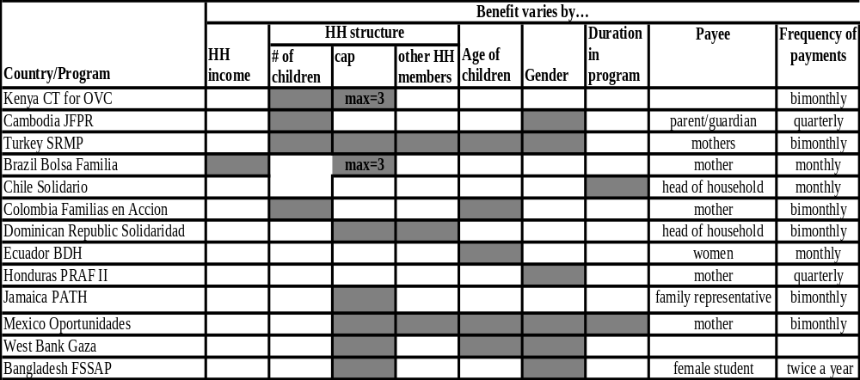
Factors taken into account in the benefit formula, CCT programs
4
For your
information

Slide 25
Benefit levels in practice
Comparisons are difficult
4
Comparative evidence is scarce
Comparison across programs and countries is difficult. Such information is presented as:
  Level of benefits expressed in local currency, when variable formulae presented at a table
  Level of benefits in comparable purchasing power (USD PPP)
  But generosity is a relative concept, differs from country to country
  In relative terms: % of min wage, average wage, poverty line, unemployment benefit, social pension
Our preferred measure:
  Generosity = benefit / consumption of beneficiary household
25

Slide 26
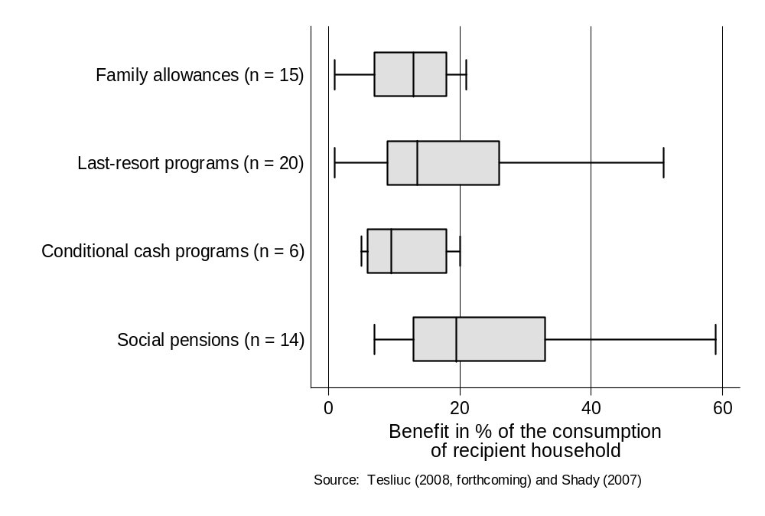
Benefit levels in practice
Limited to 4 types of programs, 2 regions
4
Generosity of Social Safety Net Programs
from ECA and LAC Regions
26

Slide 27
Outline
1
Type of safety net programs
Spending
Target group, targeting methods
Benefit level, from theory to practice
Distributional outcomes
2
3
4
5
Notes:
This paper is just a small “decoupage” from that book. It covers:

Slide 28
Targeting accuracy of different types of social assistance programs in Latin America
CCTs even outperform other social assistance transfers:
Definition of poor as target group
Explicit use of targeting mechanisms (geographic + household assessment)
Source: Lindert, Skoufias, Shapiro (2006)

Slide 29
Targeting accuracy of different types of social assistance programs in Central/Eastern Europe and FSU
Last Resort SA outperform other social assistance transfers: Definition of poor as target group; Explicit use of household-level targeting mechanisms
Source: Tesliuc et al (forthcoming)

Slide 30
Errors of exclusion in Central and Eastern Europe and FSU
5

Slide 31
Administrative costs in selected means- and proxy means tested programs are moderate
5
Caveats:
Compiling administrative costs is difficult, esp. for decentralized programs;
Comparing costs across program is difficult.
What we learned:
A certain level of administrative costs is required for the adequate operation of the program
Admin costs tend to be higher during start-up.

Slide 32
Final points
Successful safety net programs can be designed and implemented in all country setting, including middle- (MICs) and low-income countries (LICs)
In LICs, the design of the program – including the targeting method and benefit formula – tends to be simplified in line with the often lower administrative capacity:
  Targeting method:
    Proxy-means and means testing is commonly used in MICs
    Demographic, geographic, community-based targeting and self-selection are employed in LICs
  Benefit formulae: Quite complex in MICs, simplified in LICs
The generosity of safety net programs is lower in developing compared to developed countries

